Slide 1
Image fusion using MRI and CT images
BATCH-10
Mahima T P- 211418104144 Guided By
Sowmiya K- 211418104257 Dr T JACKULIN
Thokala Veshitha- 211418104294 Associate Professor

Slide 2
Introduction
In this project , we are going to combine Computed Tomography (CT) and Magnetic Resonance Image (MRI) to obtain clear image and this clear fused image has precise information compared with the original images.
The motivation is to obtain a superior exquisite image that will provide accurate and reliable statistics than any single image while retaining the best functions for the snapshots software program for medically testing, diagnosing and curing diseases.

Slide 3
LITERATURE Survey
S.NO | TITLE OF THE PAPER | TECHNIQUES | CHALLENGES
1. 2. 3. | CT and MRI image fusion based on weight difference between L1 and L2 norms (2021) Medical Image Fusion Based a Densely Connected Convolutional Networks (2021) Multi model image fusion using hybrid algorithms for brain tumor detection(2021) | Tight wavelet frame Medical image fusion method based on DenseNet, which achieves feature reuse by cochannels, and enables the algorithm to achieve better performance than traditional networks with fewer parameters and calculation costs connecting features over PrincipalComponent Analysis (PCA),Discrete Curvelet Transforms(DCT) and Stationary Wavelet Transform(SWT) | The prototype can be complex and hard to use DenseNet shows poor performance in chest radiographs classification and video action recognition. DenseNet require large amount of data to perform well and heavily starts to overfit if the dataset size is smaller This method takes a lot of time to process and load the data.

Slide 4
Problem Statement
This project addresses the problem of Clinicians suffering from inaccurate images for analysis.
Computed Tomography (CT) images show the degree of X-ray absorption by organs and tissues in different gray scales. Therefore, CT can display pathological images on good anatomical image background.
Magnetic Resonance Imaging (MRI) can clearly show soft tissue information.
In clinical radiotherapy, target volume delineation based on MRI and CT fusion images has better accuracy than single modality images.

Slide 5
DEVELOPMENT ENVIRONMENT
HARDWARE COMPONENTS | SPECIFICATIONS
Processor | Intel Core
Operating System | Windows 10 (64-bit)
RAM | 8GB
SOFTWARE REQUIREMENTS | VERSION
Python | 3.10
Flask | 2.1.2
Numpy | 1.22.3
Matplotlib | 3.5.2
Imageio | 2.19.1
Scipy | 1.8.0
Torch | 1.11.0
Torchvision | 0.12.0
Scikit-image | 0.19.2
Opencv | 4.5.1

Slide 6
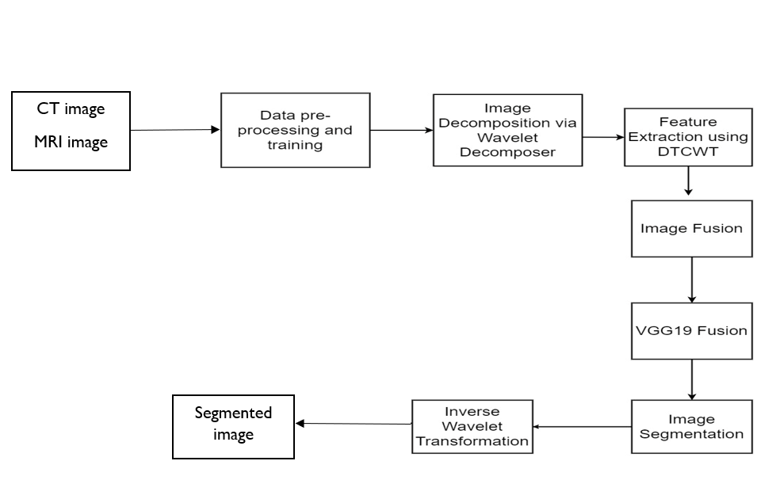
SYSTEM ARCHITECTURE:

Slide 7
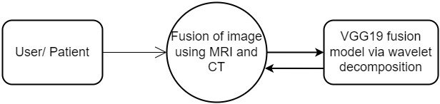
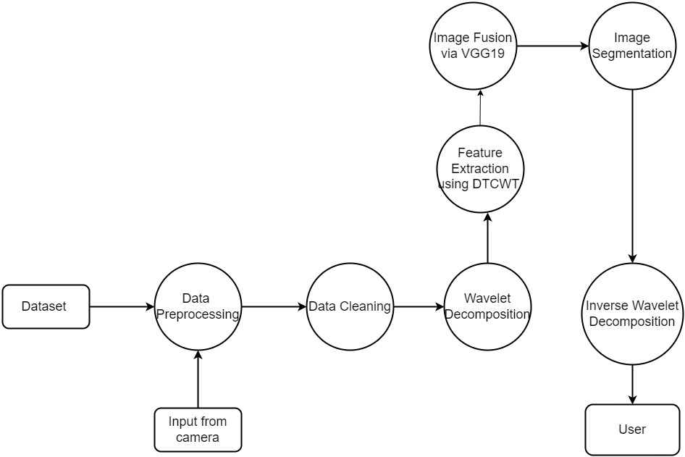
System design DFD 0 AND DFD1 DIAGRAMS:

Slide 8
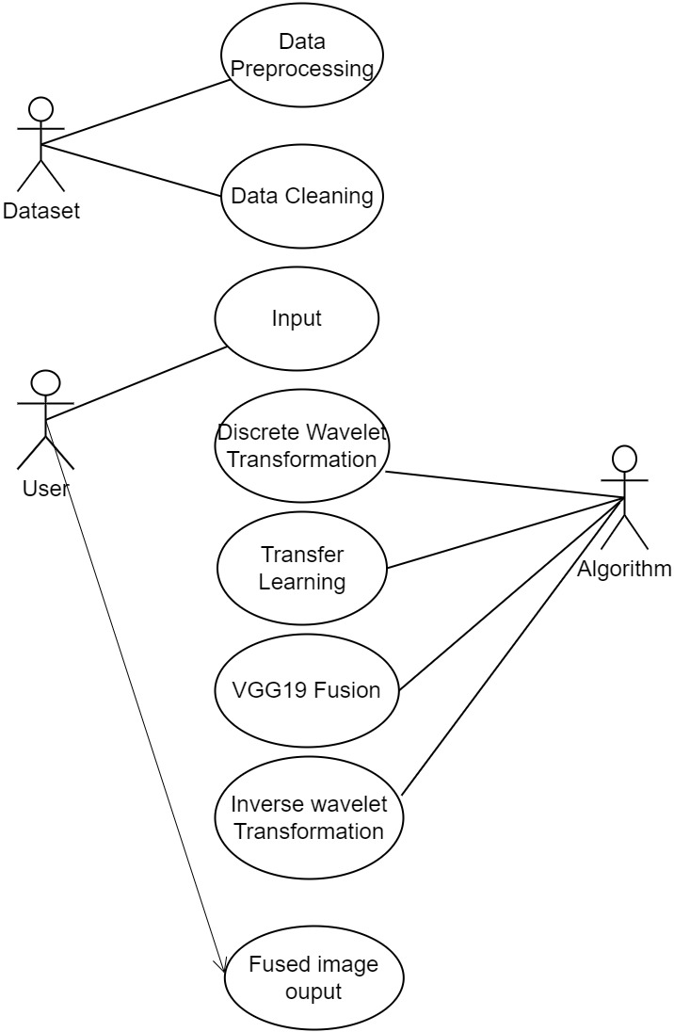
UML DIAGRAMS: USECASE DIAGRAM:

Slide 9
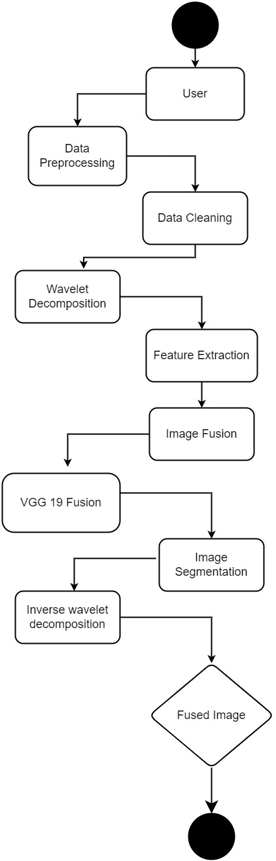
ACTIVITY DIAGRAM:

Slide 10
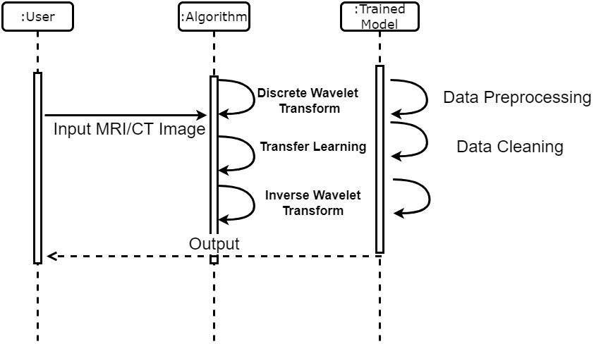
SEQUENCE DIAGRAM:

Slide 11
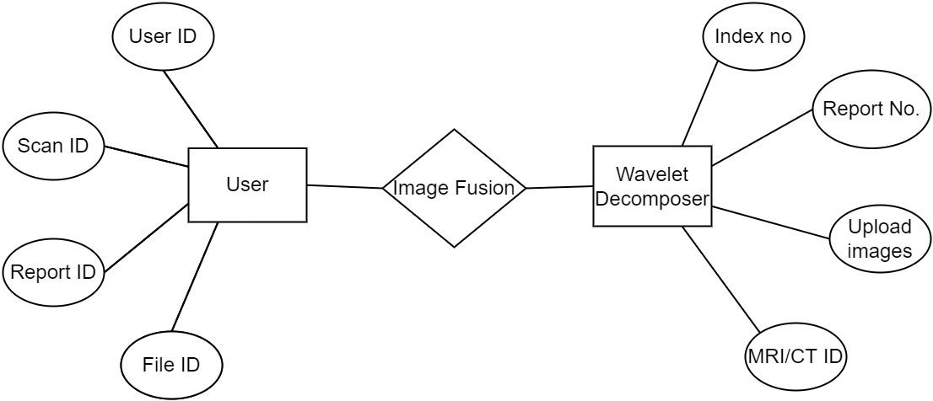
ER DIAGRAM:

Slide 12
MODULES:
Module 1: Image Decomposition
Module 2: Extracting Feature using DTCWT
Module 3: Image Fusion
Module 4: Image Segmentation

Slide 13
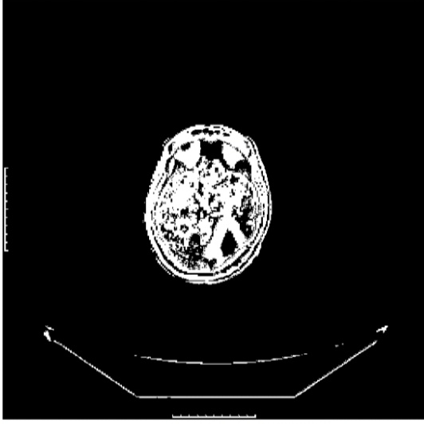
MODULE 1: Image Decomposition
In this module, we developed a website, which will prompt the user to upload the CT and MRI image of a patient.
The uploaded image is in the form of RGB. This RGB image is converted into gray scale image, which has the intensity information.
After that these source gray scale CT and
MRI image is decomposed using DTCWT.
Decomposed image

Slide 14
MODULE 2: Extracting Features using DTCWT
After decomposition we will extract the high intensity and low-intensity features. It produce the various levels of decomposed images.
The principal component analysis is used to reduce the dimension of the data, if the data is larger in size, also extract the silent and complementary features. As the medical images are larger, to reduce the data here, PCA is used. The PCA will remove the unwanted and repeated information present in DTCWT.

Slide 15
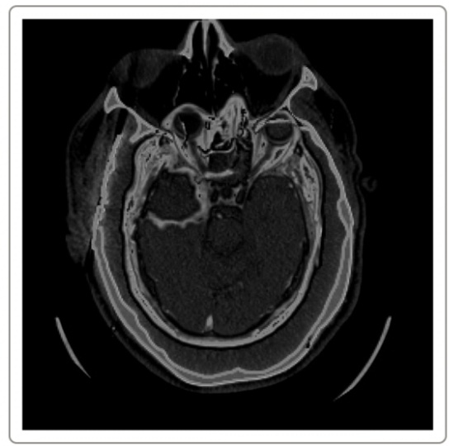
MODULE 3: Image fusion
The decomposed MRI and CT images Mri_0, Mri_1,Mri_2,Mri_3 and CT_0, CT_1,CT_2,CT_3 are fused together as fusion_0,fusion_1, fusion_2 and fusion_3.
These fusion images are passes through VGG19 and fusion image with highest probability is obtained as final fused image.
Now we apply the Inverse dual-tree complex
wavelet transform to restore the fused image.
Fused image

Slide 16
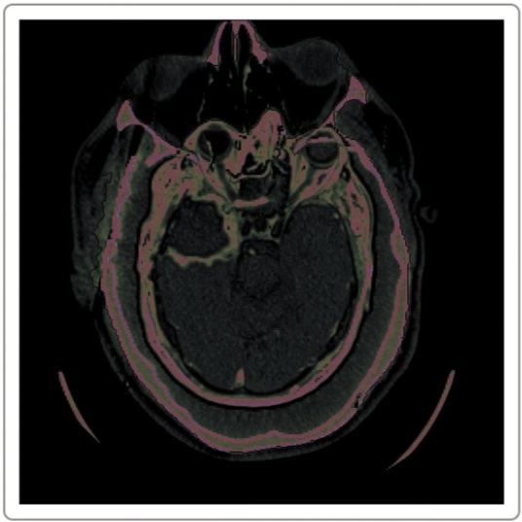
MODULE 4: Image segmentation
The segmentation is used to differentiate the details of lines, curves and boundaries. So the segmentation is performed on the final fused image.
Segmented image

Slide 17
Test cases and reports
TESTCASE ID | TESTCASE/ ACTION TO BE PERFORMED | EXPECTED OUTPUT | ACTUAL OUTPUT | PASS/ FAIL
TC01 | Upload Documents | Accept when image is chosen , if left empty display error message | File accepted when chosen and error message displayed when left empty | Pass
TC02 | Select points for image registration | Submit image for registration if correct number of points is selected else display error message | Image submitted for registration only when correct number of points are selected and error message displayed when points selected is less or more. | Pass
TC03 | Generate registered image | Confirms user with registered image | Registered image generated successfully | Pass
TC04 | Generate fused image | Displays the fused image | Image fused successfully | Pass
TC05 | Generate segmented image | Provides user with segmented image | Image segmentation done successfully | Pass

Slide 18
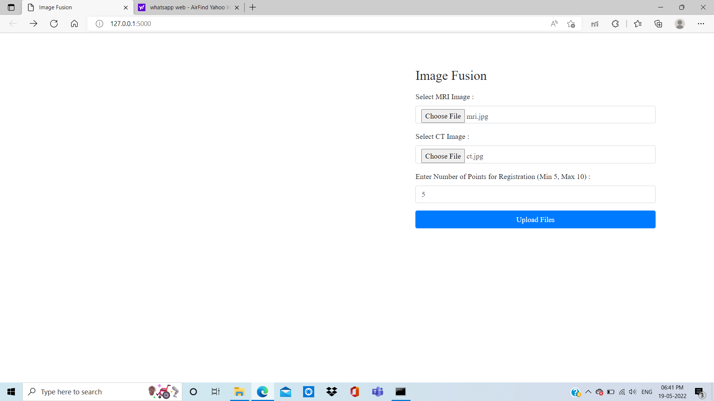
Upload page
SCREENSHOTS:

Slide 19
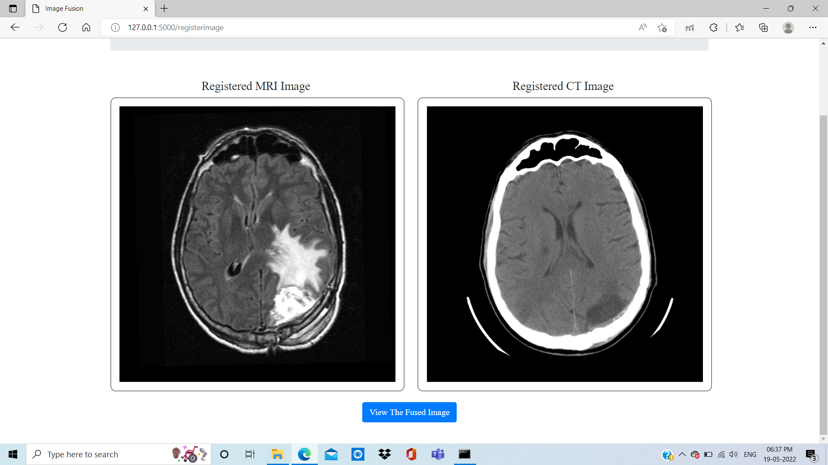
SCREENSHOTS:
Registered image page

Slide 20
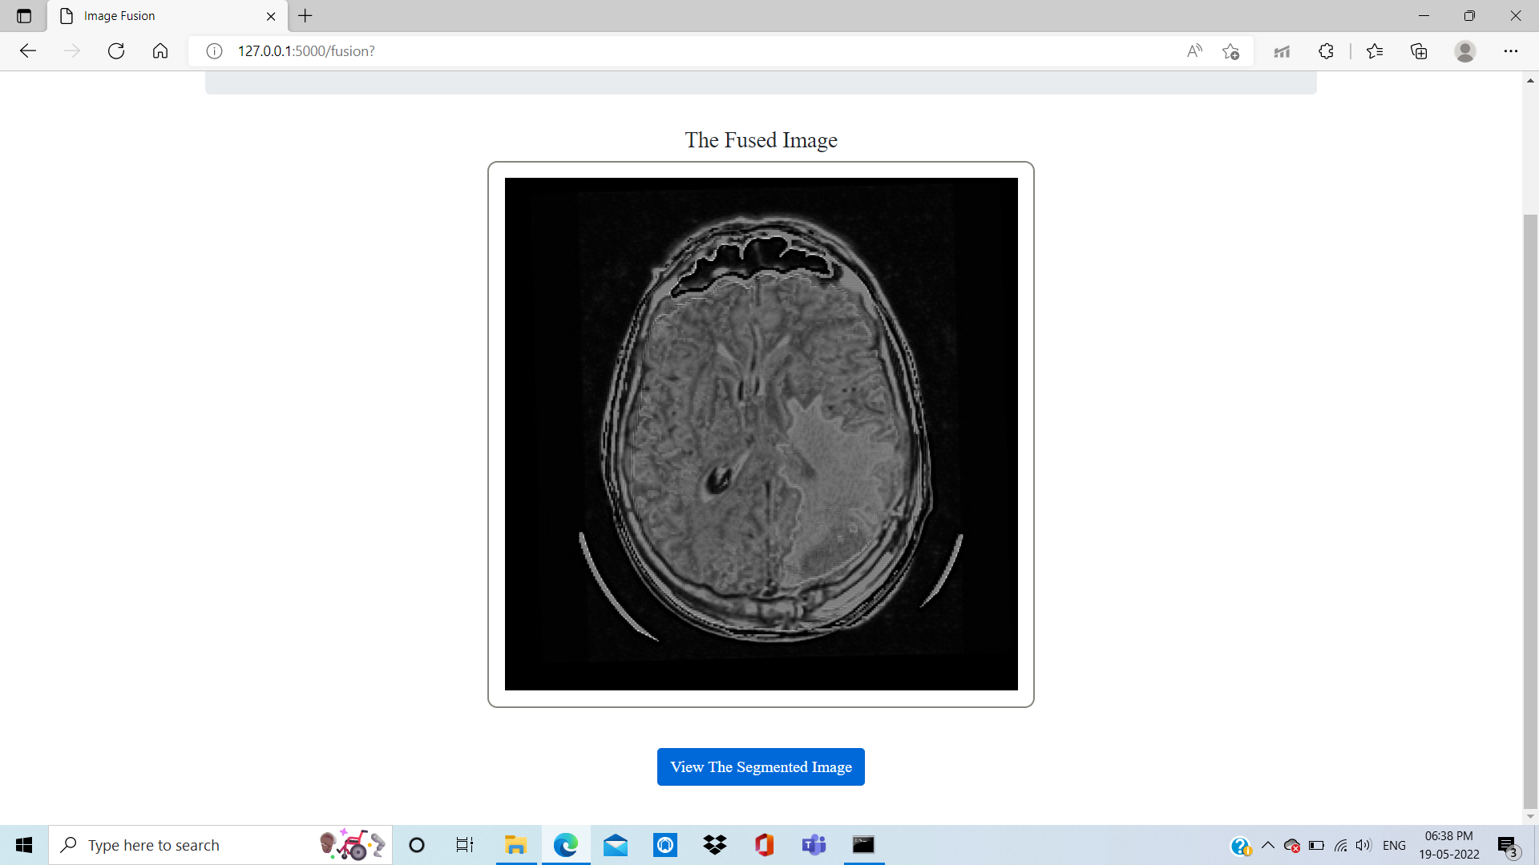
SCREENSHOTS:
Fused image page

Slide 21
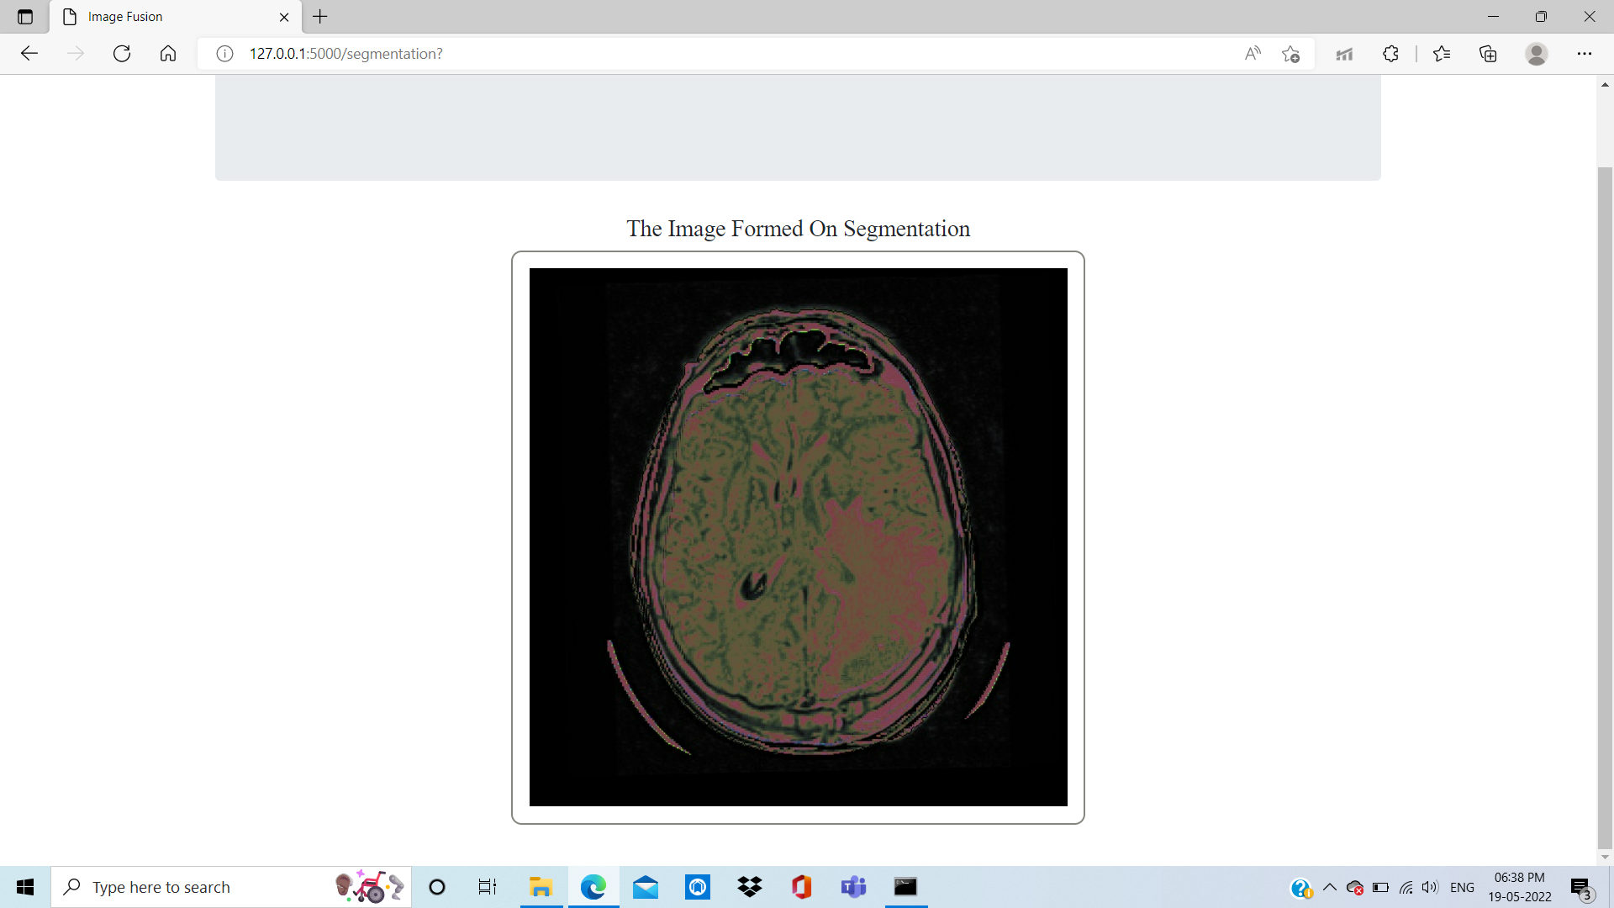
SCREENSHOTS:
segmented image page

Slide 22
PERFORMANCE ANALYSIS
Precision is the ratio between the True Positives and all the Positives. Our Project precision value is around 0.872 which would be 87 %
The recall is the measure of our model correctly identifying True Positives. Recall also gives a measure of how accurately our model is able to identify the relevant data. Our Project Recall value is around 0.865 which would be 86 %

Slide 23
Performance Analysis
O (1) is the time complexity which means that whatever is the size of the input, the time taken by the program to run is constant. That is the reason O (1) time complexity is called constant time complexity.
Accuracy is 95% where as accuracy of existing systems is only 92%

Slide 24
Conclusion
The fused image can be really helpful for the surgeons and doctor to obtain a clear image and by extracting useful information from the image.
Future work can be done by highlighting some of the cells that has the symptoms of brain tumor or any other in the fused image.

Slide 25
References
[1] Surya Prasada Rao Borra, Rajesh K. Panakala and Pullakura Rajesh Kumar ,“VLSI Implementation of Image Fusion Using DWT- PCA Algorithm with Maximum Selection Rule ,“ RajeInternational Journal of Intelligent Engineering & Systems,2019
[2] M. Pemmaraju, S. C. Mashetty, S. Aruva, M. Saduvelly, and B.B. Edara, “Implementation of image fusion based on wavelet domain using FPGA”, In: Proc. of International Conf. on Trends in Electronics and Informatics, pp.500- 504, 2017
[3] ] J. Agarwal and S.S. Bedi, “Implementation of hybrid image fusion technique for feature enhancement in medical diagnosis”, Humancentric Computing and Information Sciences, Vol.5, No.1, pp.3, 2015.

Slide 26
Thank You

